Slide 1

Dynamic Price Prediction
Team Members:
Venkata Anil Kumar Thota
Megha Rajam Rao
Nandini Puppala
Prathusha Koouri

Slide 2
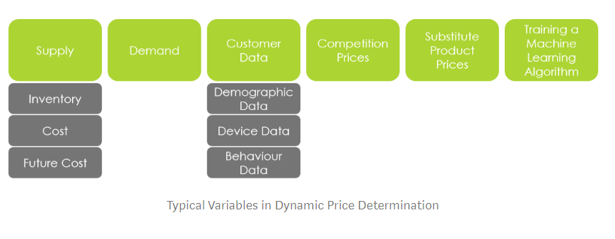
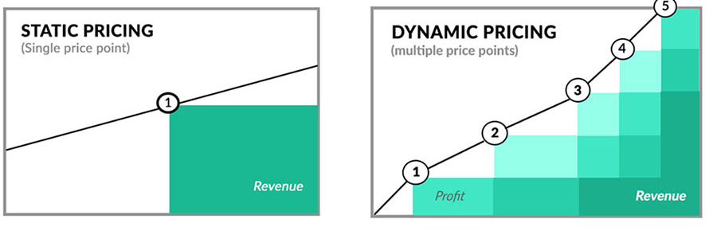
Dynamic price prediction
Dynamic pricing, otherwise known as real-time pricing or repricing, can be defined as the study of determining optimal prices for products or services, in a frequently adjustable framework.
According to McKinsey & Company, a well-balanced dynamic pricing scheme typically yields a substantial growth of 2-5% in sales and 5-10% in margins.
Source: https://www.x-cart.com/blog/pricing-tactics.html; https://medium.com/@mehulved1503/dynamic-pricing-in-e-commerce-3f0a066a3728; https://www.mckinsey.com/industries/retail/our-insights/how-retailers-can-drive-profitable-growth-through-dynamic-pricing; A. V. D. Boer, “Dynamic pricing and learning: Historical origins, current research, and new directions,” Surveys in Operations Research and Management Science, vol. 20, no. 1, pp. 1–18, Jun. 2015.

Slide 3
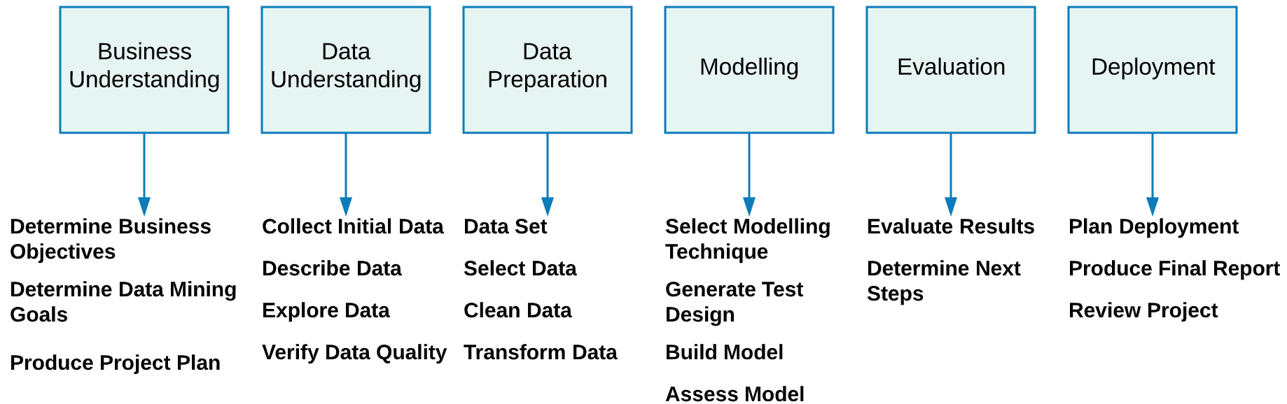
CRISP-DM Approach
Source: https://datascienceforall.wordpress.com/2016/08/06/first-blog-post/

Slide 4
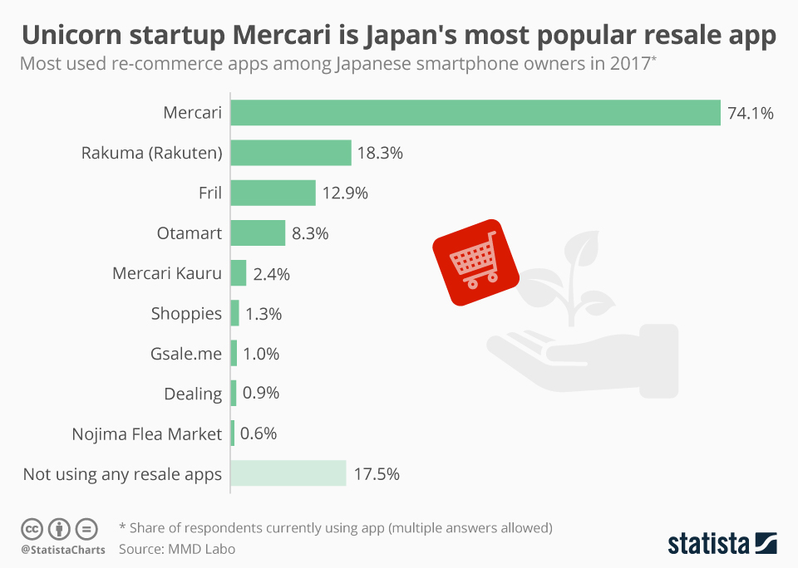
Mercari
Japanese re-commerce app where user’s sell new or used items.
C2C flea market app
1st Japanese startup to be valued at 2 billion dollars.
74% Japanese smartphone users relied on it, with 71 million downloads and 10.5 million active users.
Available in US, Japan and UK
Source: https://www.statista.com/chart/14330/mercari-japans-most-popular-resale-app/; https://expandedramblings.com/index.php/mercari-facts-statistics/
Notes:
Hypothetical business scenario - Most popular resale app in Japan exported to US and UK

Slide 5
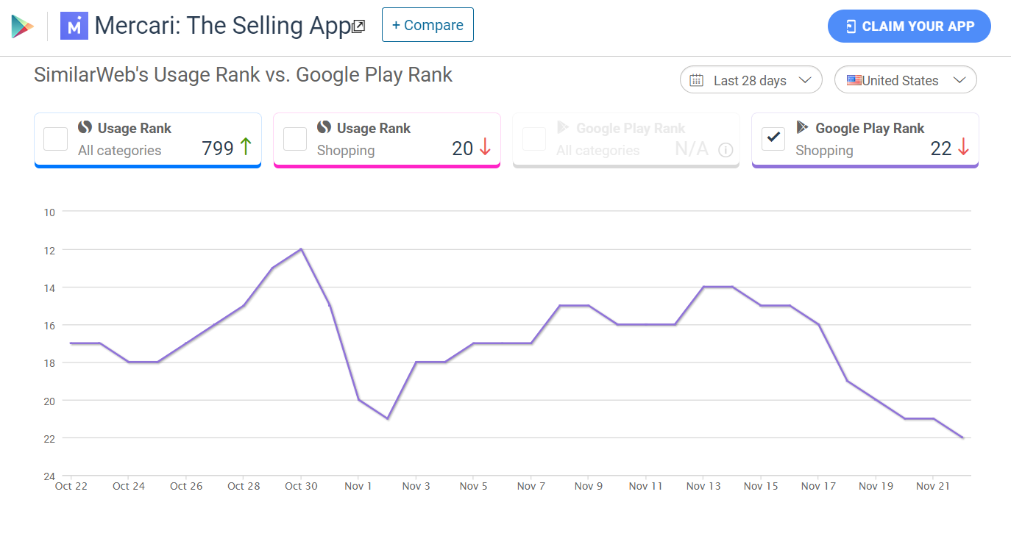
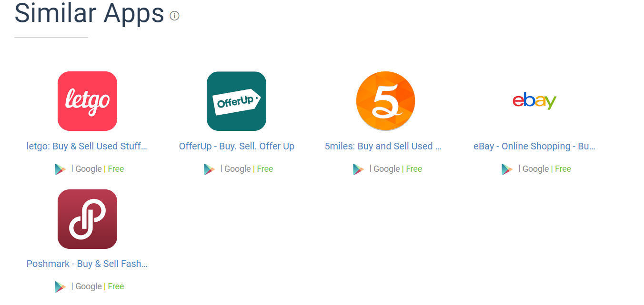

100 million avg monthly transactions
$2 billion estimated valuation
20 million downloads in the US
100 million downloads globally
According to
Source: https://www.similarweb.com/app/google-play/com.mercariapp.mercari/statistics#ranking; https://www.mercari.com/ https://www.kaggle.com/c/mercari-price-suggestion-challenge; https://expandedramblings.com/index.php/mercari-facts-statistics/

Slide 6

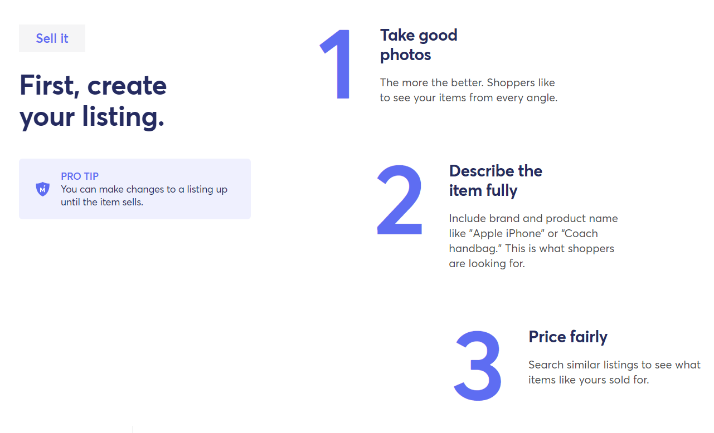
Source: https://www.mercari.com/

Slide 7
Data Understanding

Slide 8


Data Selection
Source: Kaggle
File type: tsv format
File names: train.tsv
No. of entries: 1,482,535 (approx. 1.4 million records).
Shape of the dataset: (1482535, 8)
Source: https://www.mercari.com/; https://www.kaggle.com/c/mercari-price-suggestion-challenge/overview

Slide 9
Features & target
Feature | Metadata | Type
name | The Name of the product/listing | Categorical
item_description | The description of the product/listing | Categorical
category_name | Category of the product/listing | Categorical
brand_name | The brand of the product/listing | Categorical
Item_condition_id | The condition of the items given by the seller | Multi-class
shipping | It shows whether the shipping is paid by seller or buyer | Binary
Target | Metadata | Type
price | The price that the item is sold for. Values are mentioned in Dollars. This column doesn’t exist in test data since this column is the target variable. | Numeric
Source: https://www.kaggle.com/c/mercari-price-suggestion-challenge/overview

Slide 10
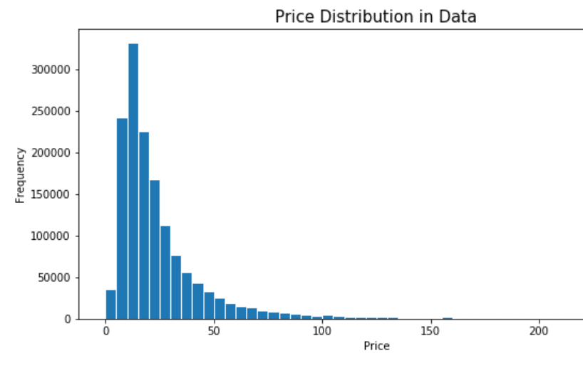
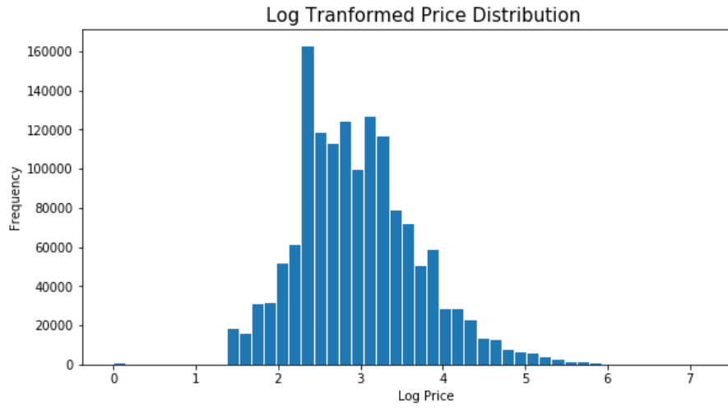
EDA - Price
95%
Coded from data source: https://www.kaggle.com/c/mercari-price-suggestion-challenge/overview

Slide 11
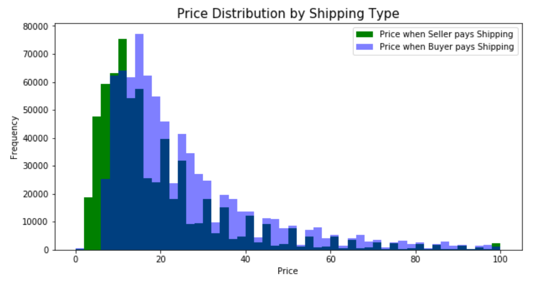
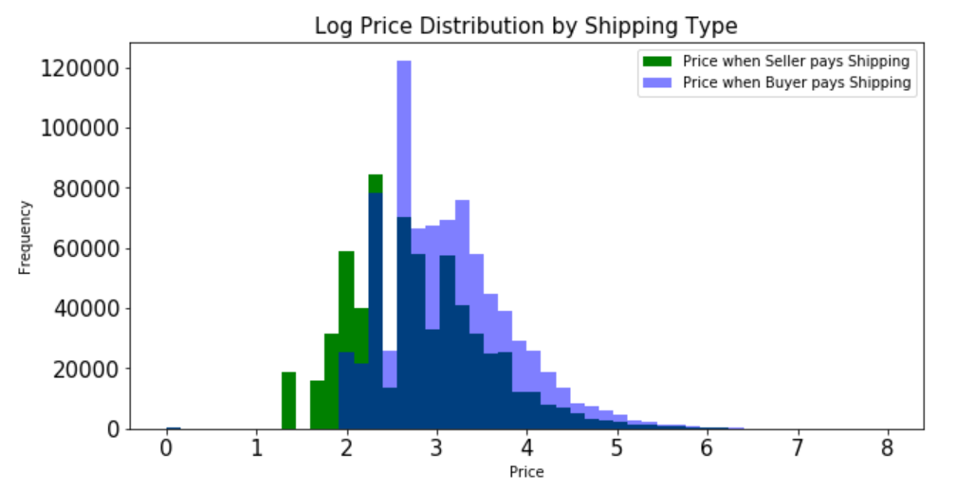
EDA - Shipping
Coded from data source: https://www.kaggle.com/c/mercari-price-suggestion-challenge/overview

Slide 12
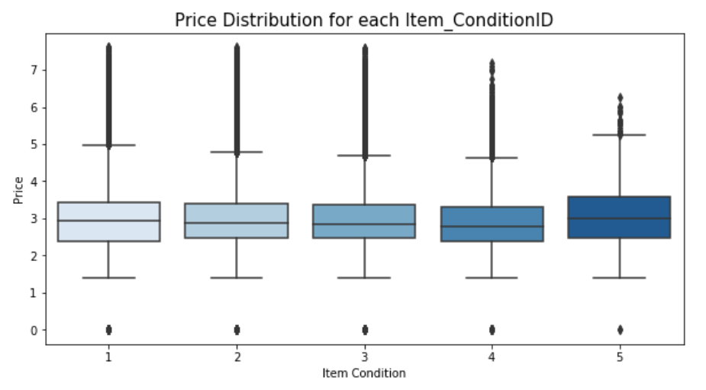
EDA - Item Condition
43% of data
0.13 % of data
1 - Like New
2 - Good
3 - Acceptable
4 - Used
5 - Damaged
Coded from data source: https://www.kaggle.com/c/mercari-price-suggestion-challenge/overview

Slide 13
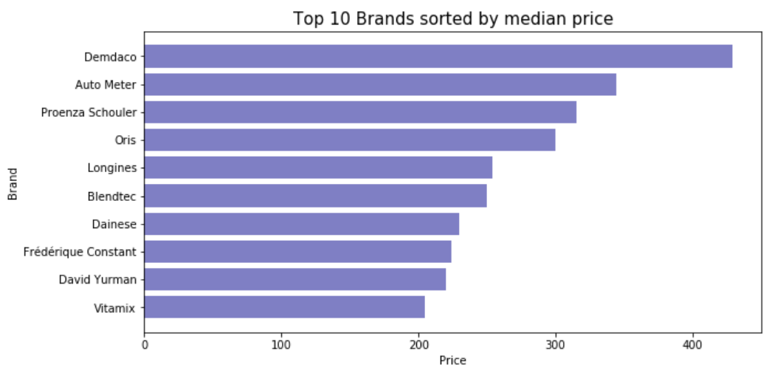
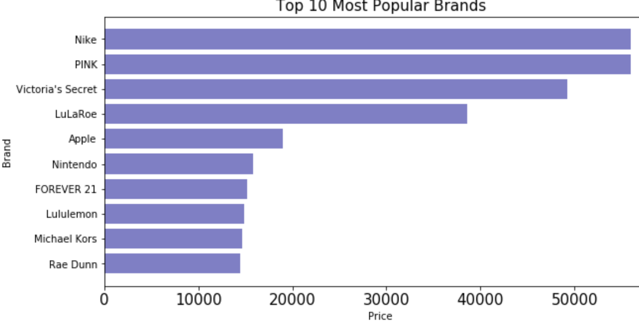
EDA - Brand Name
Before imputing Null brands
After imputing Null brands
Coded from data source: https://www.kaggle.com/c/mercari-price-suggestion-challenge/overview

Slide 14
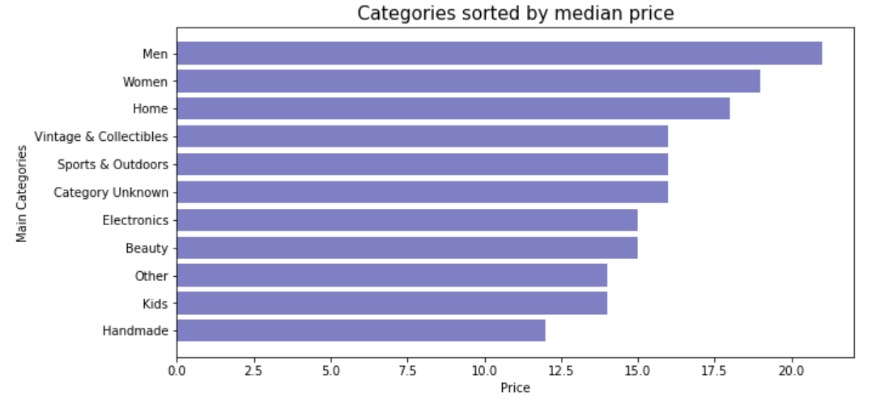
EDA - Category
Coded from data source: https://www.kaggle.com/c/mercari-price-suggestion-challenge/overview

Slide 15
Data Preparation

Slide 16
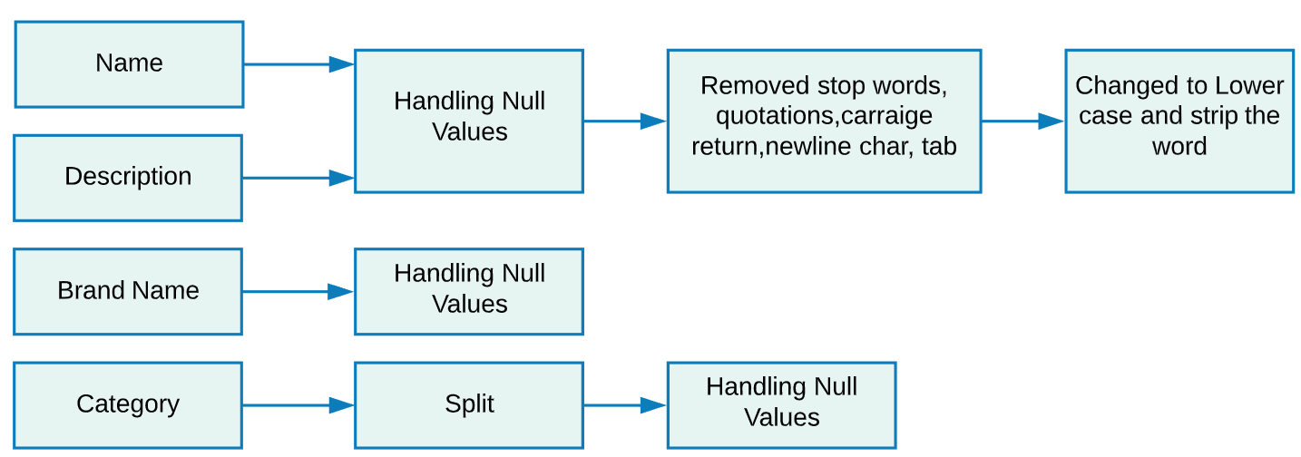
Data Pre-Processing
Data
pre-processing

Slide 17
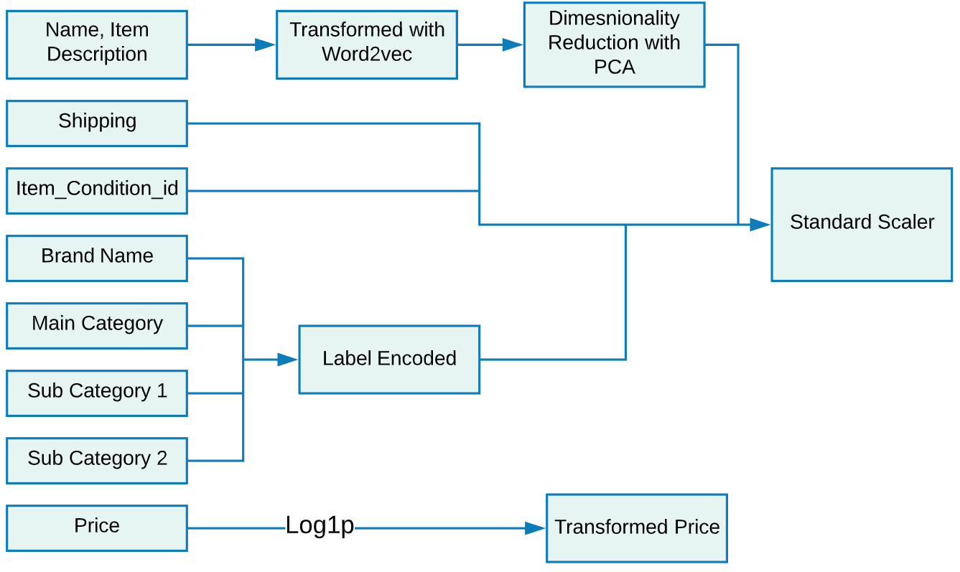
Data
Transformation

Slide 18
Data Modeling

Slide 19
Experiments including/excluding listed components
Tf-idf / Count Vectorizer/ Word2vec
IMPUTING NULL BranDS
Price Statistics
Descriptive Statistics
Name & description
Notes:
Word2vec produces one vector per word, whereas tf-idf produces a score. Word2vec is great for going deeper into the documents we have and helps in identifying content and subsets of content. Its vectors represent each word’s context. (i.e the n-gram of which it is a part)

Slide 20
Algorithms
Traditional Machine Learning | RMSLE
Linear Regression | 0.56
Support Vector Machines (SVM) | 0.55
Decision Tree | 0.58
eXtreme Gradient Boosting (XGBoost) | 0.61
Random Forest | 0.51
Deep Learning | RMSLE
Long-short term memory (LSTM) with Label Encoding | 0.62
LSTM with One Hot Encoding | 0.39
Multilayer perceptron (MLP) | 0.18
Convolutional neural network (ConvNet or CNN) | 0.16
Best model
Data source: https://www.kaggle.com/c/mercari-price-suggestion-challenge/overview

Slide 21
Evaluation Metrics
MAE
Mean Absolute Error
MSE
Mean Squared Error
RMSE
Root Mean Square Error
RMSLE
Root Mean Square Logarithmic Error

Slide 22

DEMO

Slide 23
Tools and Technologies
Python
HTML
CSS
Flask
AWS
GCP
Google Colab and Spyder

Slide 24
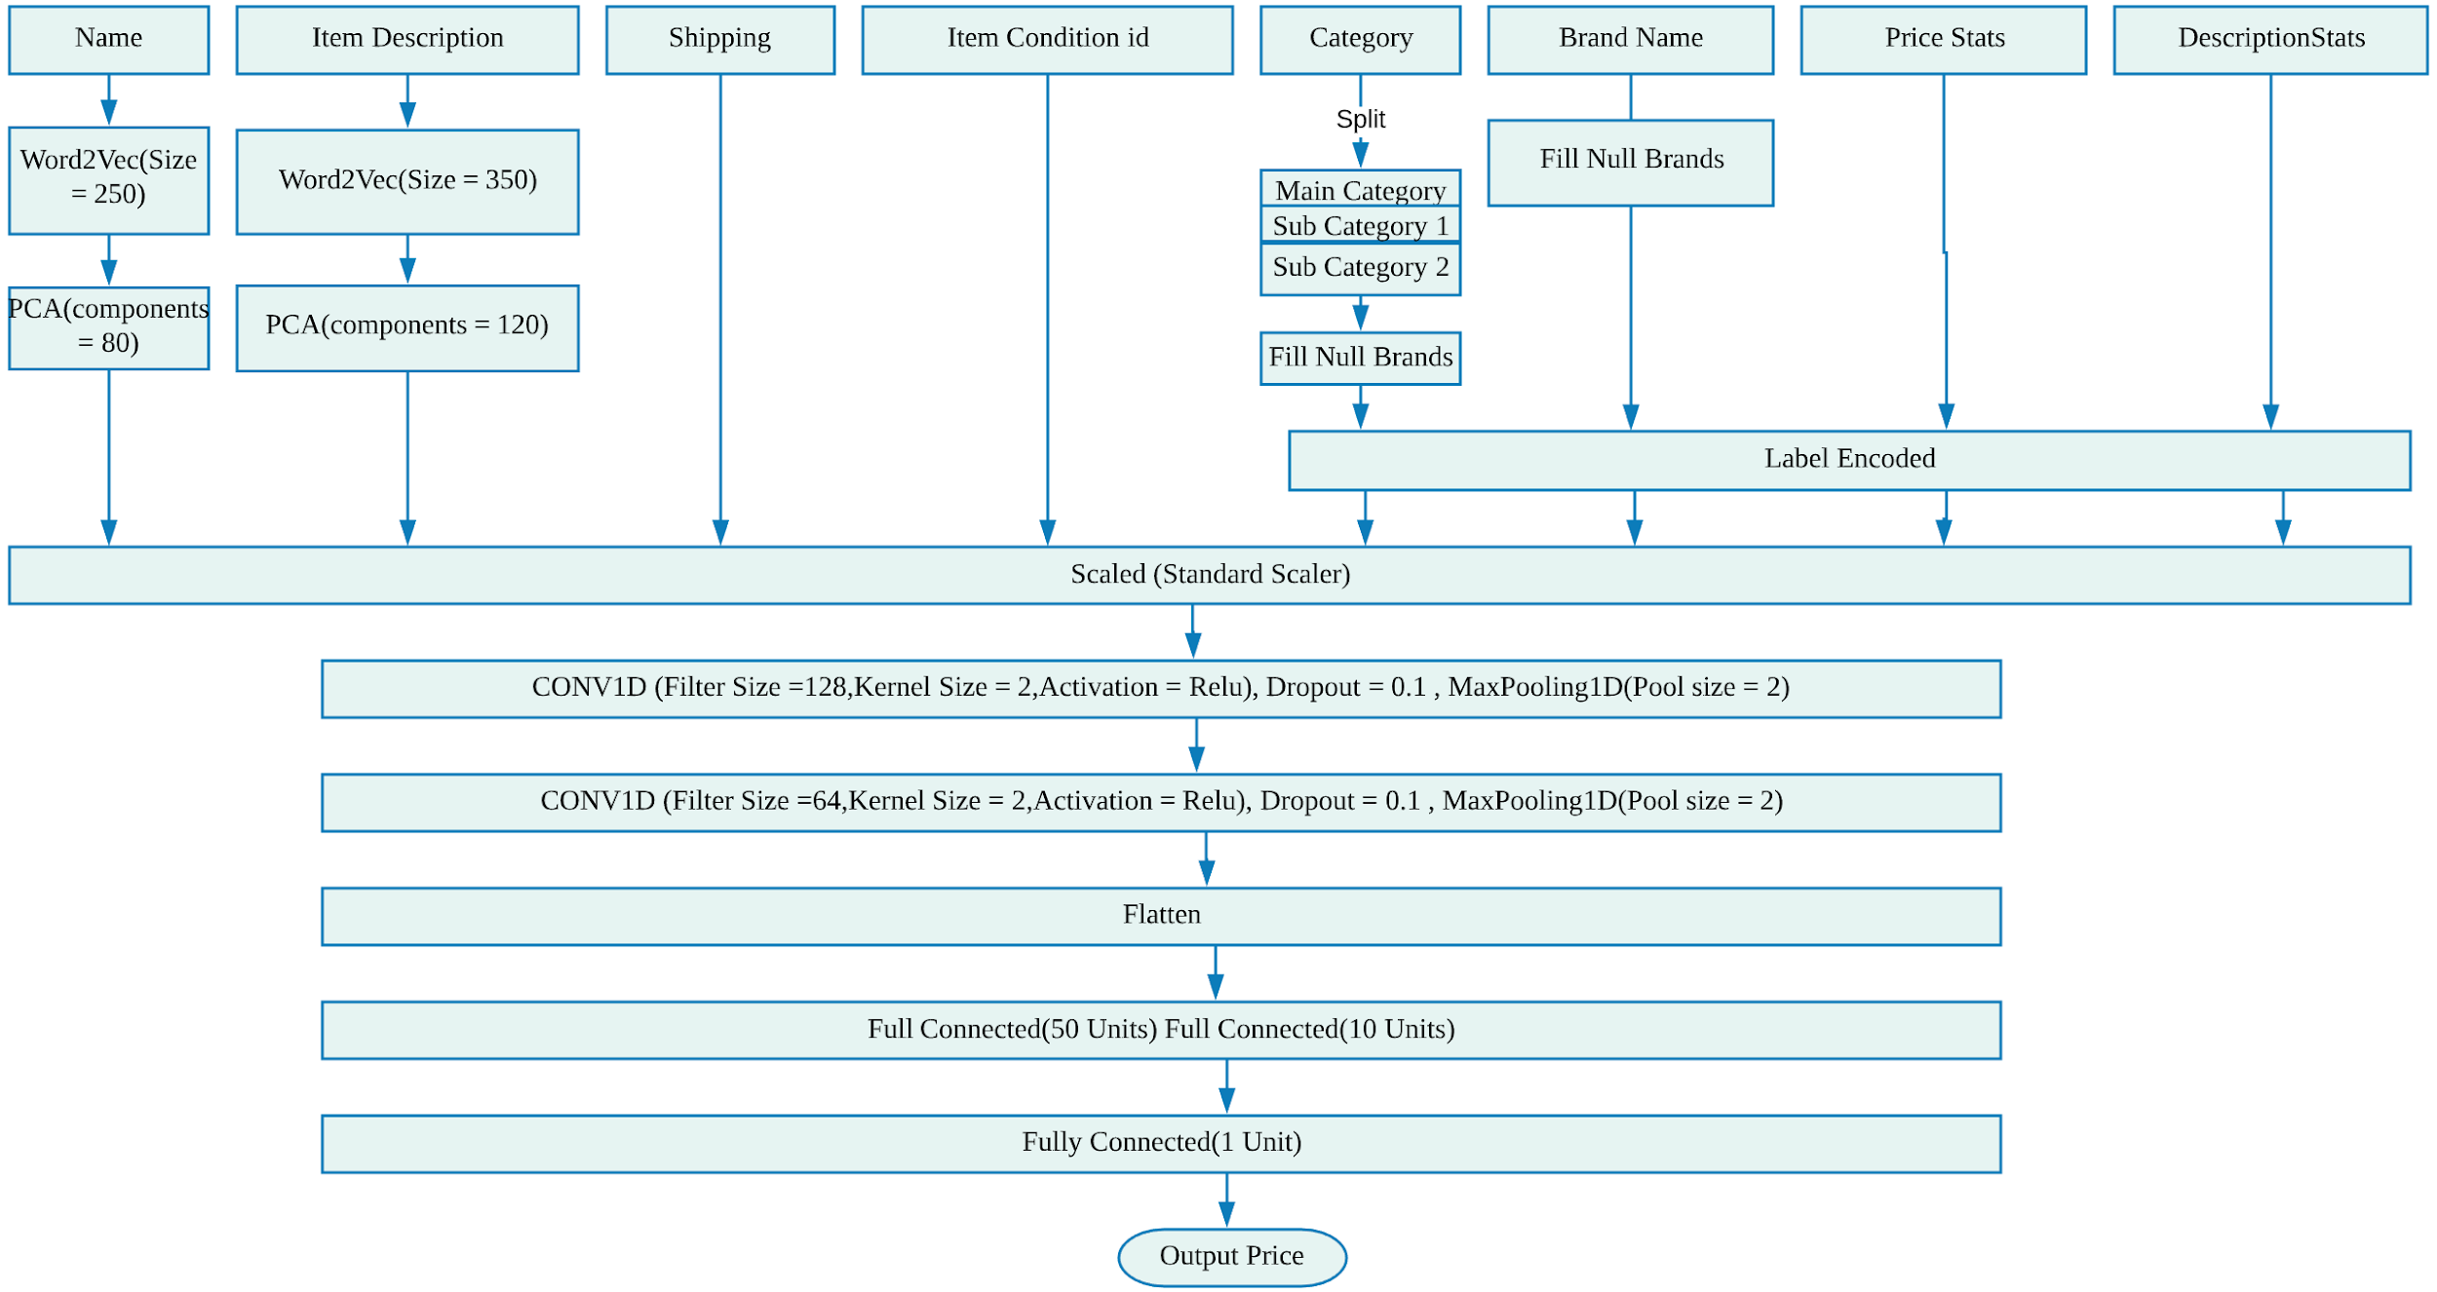
Model Architecture

Slide 25
Thank you!

